Slide 1
Fundamentals of Biochemistry and Biophysics
INTRODUCTION
In this course we will survey modern biophysical techniques used for the characterization of biological macromolecules in the solution state. We will cover hydrodynamic theory of transport processes in solution, and discuss practical applications of these techniques to current problems in biophysics, biochemistry, structural- and molecular biology, and provide a comprehensive introduction into solution biophysics. Students will gain insight in how these methods can be used for problem solving in modern research.
This course is intended for graduate students and 3rd year undergraduates or higher with an interest in analytical or physical biochemistry.

Slide 2
Fundamentals of Biochemistry and Biophysics
INTRODUCTION
University of Lethbridge: Dr. Borries Demeler (demeler@gmail.com) – Analytical ultracentrifugation
University of Montana: Dr. Emre Brookes (emre.brookes@umontana.edu) – Small angle X-ray and neutron scattering
Dr. Sandy Ross (sandy.ross@umontana.edu) – Fluorescence spectroscopy
Dr. Alexey Savelyev (alexsav.science@gmail.com) – Molecular dynamics
Information about class schedule, notes and assignments can be found at:
https://demeler.uleth.ca/biophysics/index.html
Class materials will be made available in the download archive

Slide 3
Fundamentals of Biochemistry and Biophysics
INTRODUCTION
Course delivery: the course will be presented via video conference (using Zoom, click to download client) in collaboration between the University of Montana in Missoula, Montana and the University of Lethbridge in Alberta.
Grading: 4 homework sets (20% each) and a 30-minute presentation (20%) on an assigned paper; there will not be a midterm or final exam.
Calendar: The class is coordinated with the academic calendars of the University of Montana and the University of Lethbridge, with lectures on the following days in 2019: January 10, 15, 17, 22, 24, 29, 31, February 5, 7, 12, 14, 26, 28, March 5, 7, 12, 14, 19, 21, April 2, 4, 9, 11, 16.

Slide 4
Fundamentals of Biochemistry and Biophysics
INTRODUCTION
Life and nonlife are composed of the same matter and energy.
Life and nonlife differ by how matter and energy are arranged.
Life is characterized by exceptionally complex arrangements of atoms (molecular and supramolecular structures).
These arrangements form dynamically, and over time they undergo changes in conformation and in complex interactions.

Slide 5
Fundamentals of Biochemistry and Biophysics
Understanding life on a molecular level involves understanding the arrangements of these complex molecular structures, their conformational changes, and how their interactions are regulated and controlled.
Study of these processes gives insights into the fundamental structure and function of life’s building blocks and allows us to study diseases that occur when these carefully calibrated equilibria fail (when regulation and control no longer function).
Biochemical and biophysical methods and instrumentation can help provide this understanding and help us investigate these biological processes by using tools from chemistry and physics.

Slide 6
Fundamentals of Biochemistry and Biophysics
Matter and Energy
Atomic nature of matter: atoms and molecules in motion create heat, pressure, diffusion. Measurement of these parameters provides information on molecular number, size, mass and shape.
Atoms and molecules have mass and charge: they will move in response to an external gravitational/centrifugal or electric field. Rates of their movement in response to such fields provide information on molecular mass, charge, size and shape.
Electromagnetic radiation: speed, amplitude, frequency (energy), phase, polarization, absorbance and emission (frequency or wavelength); constructive and destructive interference.

Slide 7
Fundamentals of Biochemistry and Biophysics
Matter and Energy
Interaction between electromagnetic radiation and matter: elastic and inelastic scattering, absorption and emission (wavelength), resonance (relationship to electronic or nuclear structure), refraction, diffraction, reflection.
Interrogation of biological matter with electromagnetic radiation or thermal energy provides information on the structure (positions and types of atoms and their chemical bonding) and dynamics (movements of the atoms), and their interactions and distances from each other.

Slide 8
Fundamentals of Biochemistry and Biophysics
Matter and Energy
Frequencies of absorbed or emitted radiation are determined by electronic and nuclear structure and the local environment around an atom or molecule. Spectroscopic methods therefore provide information on the composition, chemical environment & bound state of an atom.
The spontaneous loss of absorbed radiation results either in heat or emitted light (fluorescence or phosphorescence), which can be used to probe distances by resonance transfer.

Slide 9
Fundamentals of Biochemistry and Biophysics
Matter and Energy
Instrumentation is used to generate the thermal/electromagnetic radiation or centrifugal/electric fields that are used to interrogate biological material and to extend the sensitivity, reliability, precision and resolution with which radiation is measured, as well as to allow detection of radiation that is otherwise invisible to human senses.
Equations and algorithms describe quantitatively how a change in a measurable parameter (amplitude, frequency, position, phase, radiation or thermal energy scattered/emitted/absorbed by matter) is related to otherwise undetectable atomic features of the matter.

Slide 10
Fundamentals of Biochemistry and Biophysics
As Biochemists and Biophysicists we need to:
Understand the underlying chemistry
Understand the capabilities of the instrumentation
Ask the right questions
Design the right experiments to test our hypotheses
Build appropriate models
Collect the appropriate data
Properly analyze the data
Interpret the results
Combine information from multiple methods to arrive at an answer

Slide 11
Course Overview
Macromolecular Structure and Function
George Scatchard (1892-1973) – His Five Questions:
How many? (value of "n" for interacting components)
How tightly? (binding constants or free energies)
Why? (physical chemical nature of binding site)
Where? (physical location of binding site)
What of it? (significance of interaction)

Slide 12
Course Overview
Interrogation of Macromolecular Structure and Function
Solution-based Biophysical Methods and Techniques:
Absorption and Emission Spectroscopies
Transport Properties
Diffusion
Sedimentation
Solvation/Hydration
Light Scattering
Analytical Ultracentrifugation
Small Angle Scattering
Bead Modeling
Experimental Design

Slide 13
Course Overview
Interrogation of Macromolecular Structure and Function
Data Analysis and Modeling
Model Building
Exact models, inverse problems and parametric models
Neural Networks and machine learning
Data Fitting
Linear vs. nonlinear optimization, linearization
Grid searches and Monte Carlo
Effect of noise on results
Statistical analysis
Applications

Slide 14
Course Overview
Interrogation of Macromolecular Structure and Function
It is useful to define molecular weight averages
In polymer chemistry, we have the following definitions:
Number average: (Σ N_{i} × M_{i}) / Σ N_{i}
(e.g., osmotic pressure)
Weight average: (Σ N_{i} × M_{i}²) / (Σ N_{i} × M_{i})
(e.g., diffusion, sedimentation equilibrium)
Z average: (Σ N_{i} × M_{i}³) / (Σ N_{i} × M_{i}²)
(e.g., quasi-elastic (dynamic) light scatter)

Slide 15
Course Overview
Interrogation of Macromolecular Structure and Function
Questions to consider
Is the sample homogeneous (i.e., pure)?
If single component, what is the molecular weight?
If multiple components, what is the molecular weight distribution?
Are interactions/associations thermodynamically reversible?
What are the shapes and sizes of components and complexes?
Do different macromolecules have (significantly) different densities (specific volumes)?
Can conformational changes be measured?
Can we account for nonideality as real molecules do occupy space?

Slide 16
Course Overview
Molecular Dynamics: tool to model complex biological systems
Computer modelling is used to provide insight and understanding of how complex systems behave beyond what theory and experiment could deliver separately. It bridges theory and experiment by solving state equations numerically.
Two primary roles of MD simulations:
Test models which explain experiments
Test theoretical predictions
Driving forces:
Computers are fast enough for numerical experiments
Most models are too complicated for purely theoretical reasoning
There are phenomena which can not be observed directly by experiments
Theory
Experiment
Solution
Computational Modeling

Slide 17
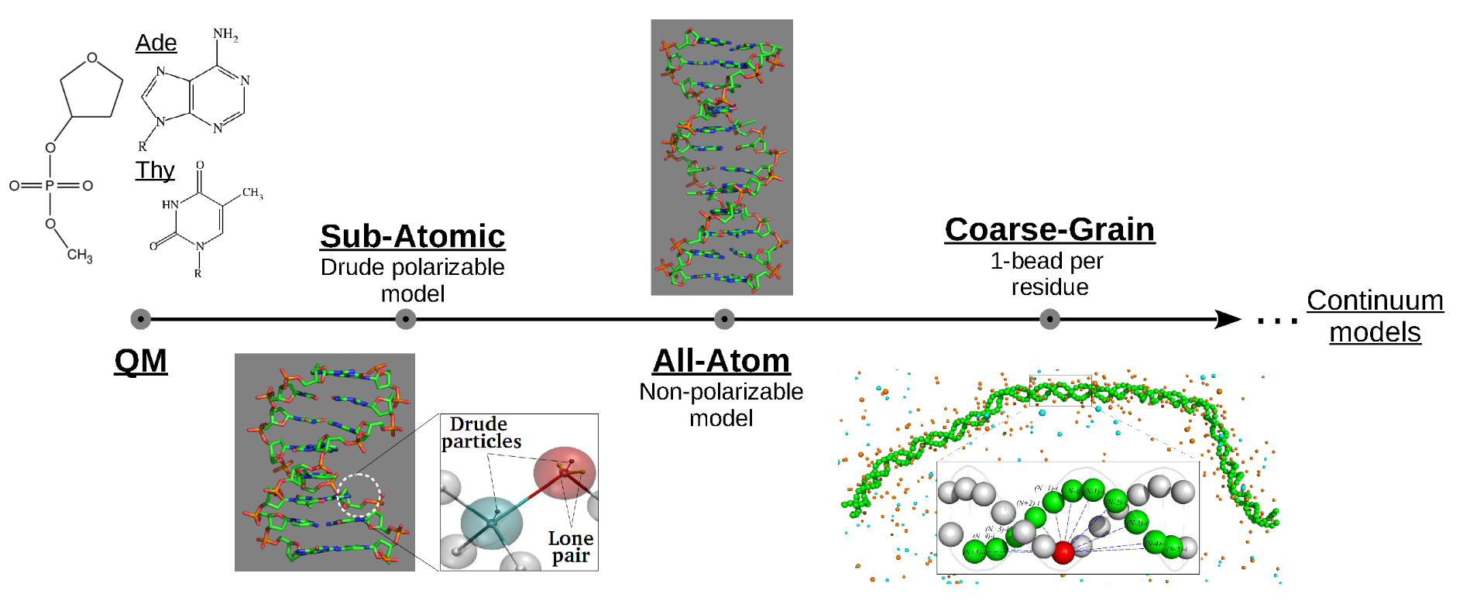
Course Overview
Molecular Dynamics: tool to model complex biological systems
Molecular Dynamics: place on the time and length resolution scales
rely on empirical force fields without accounting for electronic properties (NO change in chemical nature – bond breaking or forming) + affordable and used as virtual experiment: can handle large systems ~10¹² atoms
DNA modelling on multiple scales
10⁻¹²-10⁻⁶ s
Up to μs-ms

Slide 18
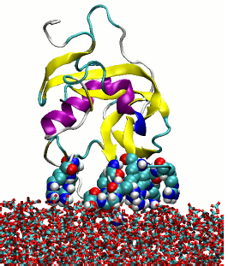
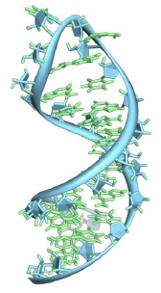
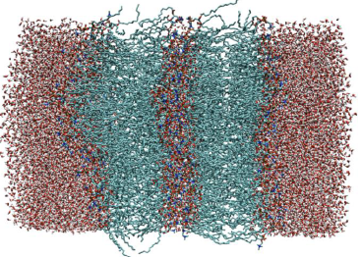
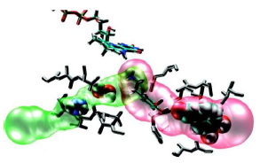
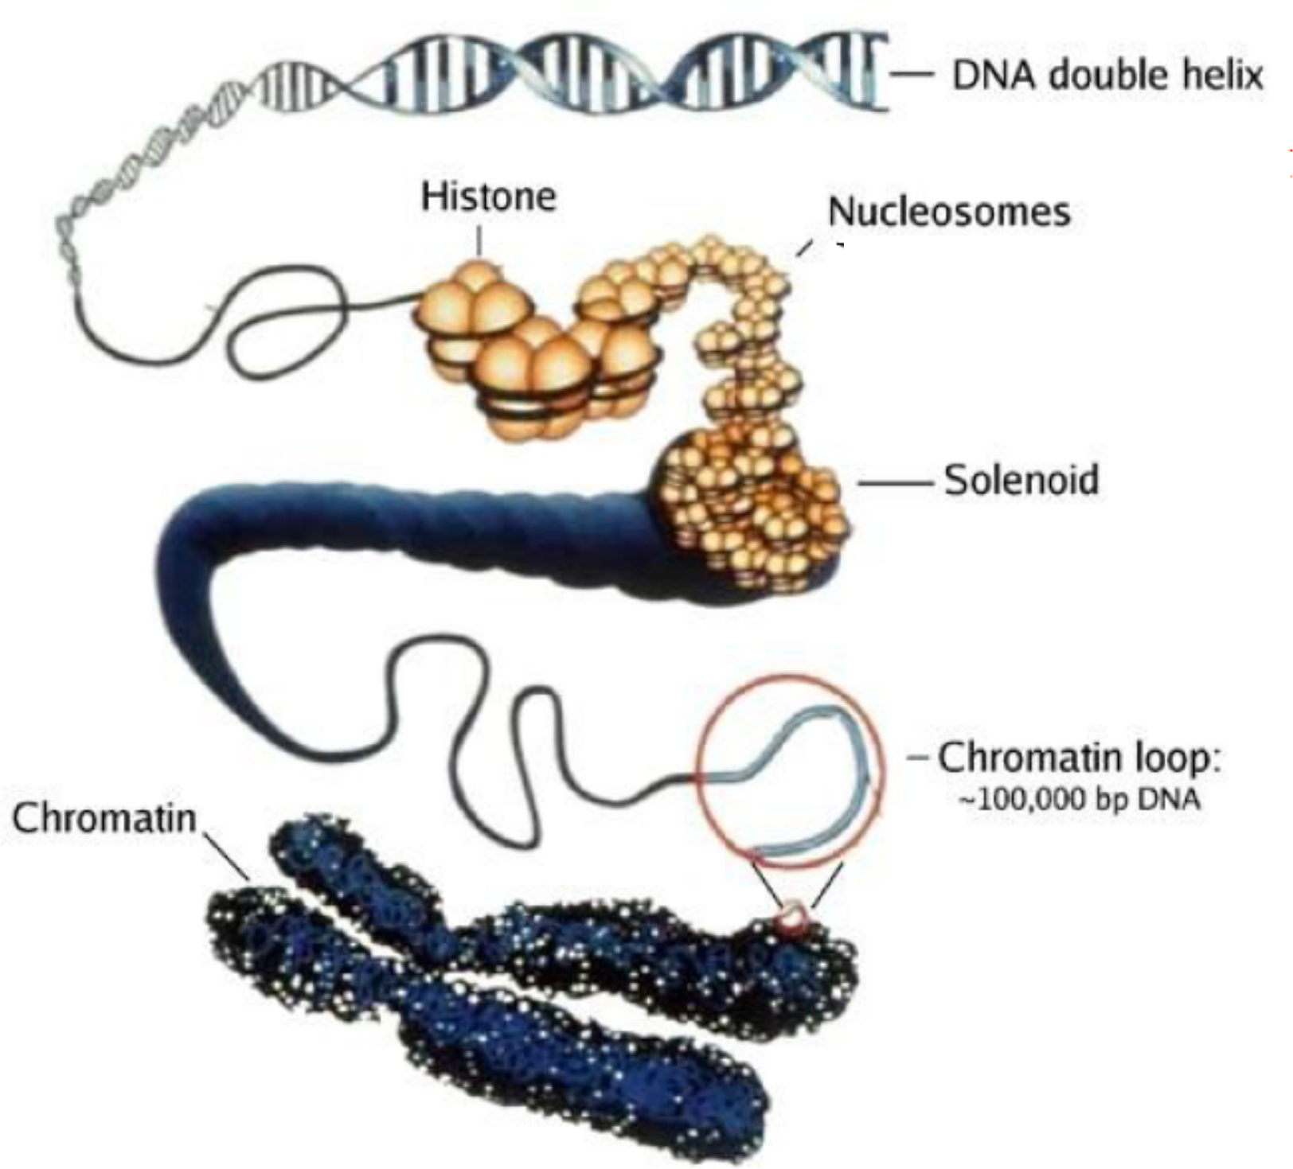
Course Overview
Molecular Dynamics: examples of model systems
Atomistic resolution (with or without polarization effects)
Small model compounds, drug discovery
Protein solvation, dynamics, binding
DNA dynamics, conformation
Membrane processes
Coarse-grained resolutions
From nucleosome core particle → to chromatin folding !

Slide 19
Course Overview
Molecular Dynamics: what can be measured/studied ?
Free energy (of binding, solvation, interaction) differences
Transport properties
Diffusion coefficients, viscosity
osmotic pressure
Partial specific volume (Dr. Demeler)
Reaction rates, phase transition properties
Protein folding times, hierarchical organization of protein’s energy landscape
Structure refinement
SAXS/SANS (Dr. Brookes )

